Slide 1


Meteorites:
Introduction to methods
Identification and classification
EL YAZIDI Mayssa
Le 31/03/2016 – Kélibia

Slide 2
Plan
Introduction
Terminology
Origin
Identification criteria
Classification
Conclusion

Slide 3
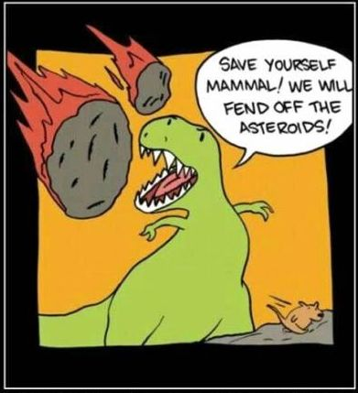
By chance during a walk, perhaps a stone has caught your eye with its unusual appearance, a different stone from surrounding. You are in the presence of an alien ?! A meteorite !
What is a meteorite ?
A piece of extraterrestrial rock 4.5 billion years old. Testimony about the origin and composition of the different bodies in the solar system.

Slide 4
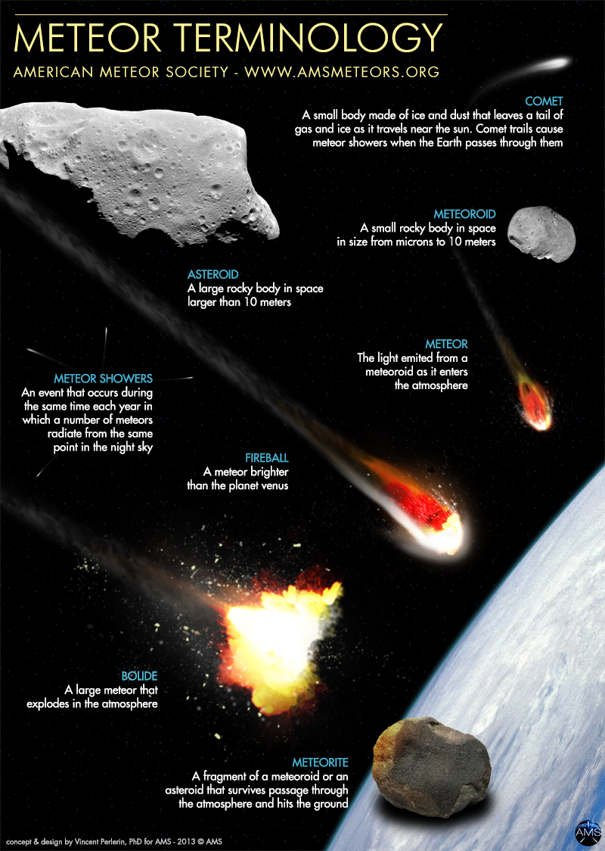
Asteroids: the larger pieces of rock that come from the asteroid belt between the orbits of Mars and Jupiter.
Meteoroids: smaller space debris of an asteroid. Entering the Earth's atmosphere they are so small that they evaporate completely and never reach the surface of the planet.
Meteora: Meteoroids that enter the Earth's atmosphere.
Meteorites: any part of a meteor that survived its fall into the atmosphere and lands on Earth.

Slide 5
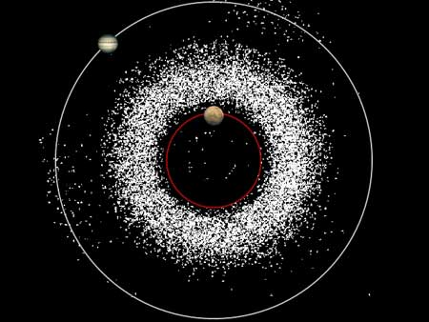
What is the origin of meteorites ?
Asteroids.
The planets.

Slide 6
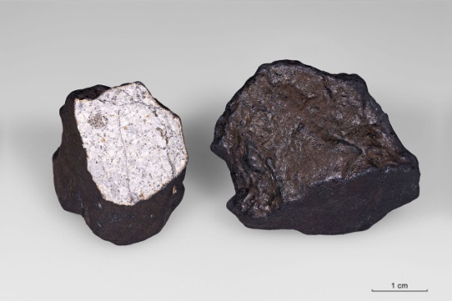
Identification criteria: :
Some serious indications, within reach of the amateur, will help in the identification of a meteorite.
1- Magnetism :
The majority of alien stones have metal (an alloy of iron and nickel) so you have to have if the stone is drawn or not a magnet.
The presence of metal grains scattered amidst the rock is also characteristic of meteorites.
Nickel test, by the dimethylglyoxime.
2- The fusion crust :
Ferrous or stony meteorite: a smooth fusion crust, usually black, the result of surface melting of the material during the passage through the atmosphere. Usually, mate. If it is glossy, it may be an achondrite.

Slide 7
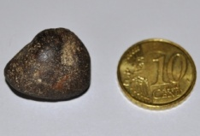
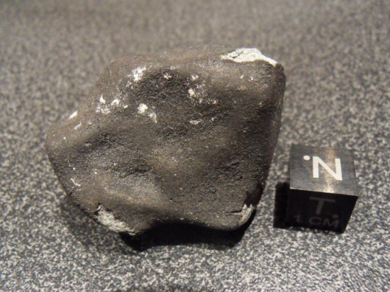
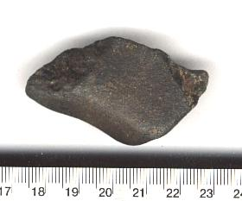
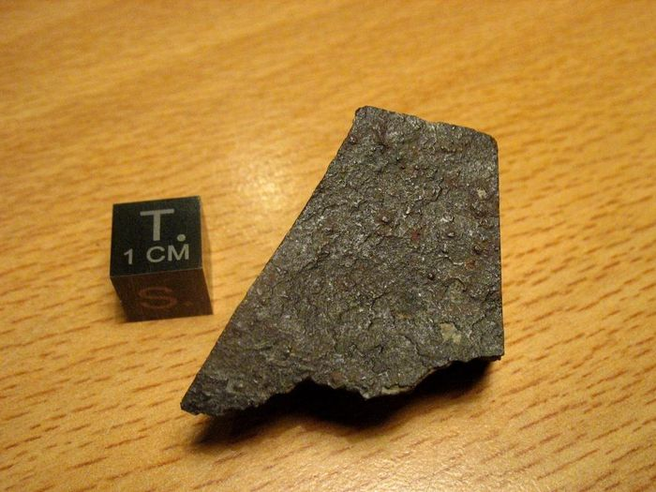

3- The form :
Rounded, angular, or very compact and solid.
Occasionally, meteorites have "depression" called "regmaglypts" due to the removal and the rapid passage of the meteor through the atmosphere.
4- La densité :
4- the density:

Slide 8
Meteorite classification:
Two broad categories of meteorites, by origin:
Non-Differentiated meteorites (primitive): reflects the material protoplanetary disk during condensation.
The differentiated meteorites are the result of separation by gravity between a dense core (iron + nickel) and a less dense coat formed silicates.
Mixed stony meteorites called metallo-siderolites.
Rich meteorites made of metal (alloy of iron and nickel) or siderites.
Stony meteorite or meteorites.

Slide 9
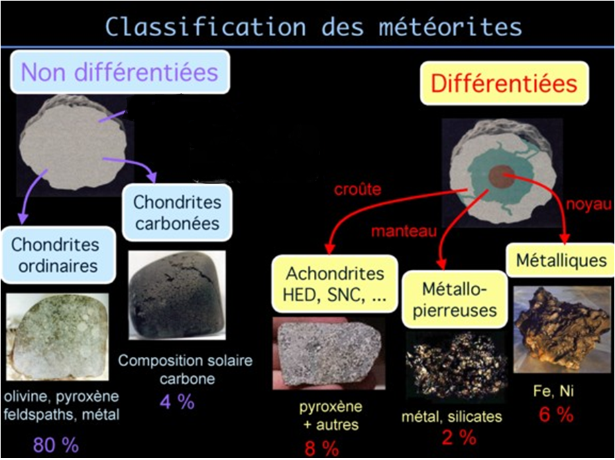
Classification of meteors

Slide 10
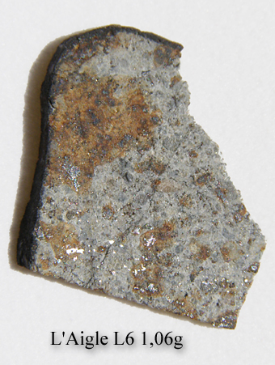
The stony
(92% of meteorites)
Consisting mainly of silicates.
There are two kinds:
* Chondrites (formed chondrules)
* Achondrites (which have no chondrules)

Slide 11
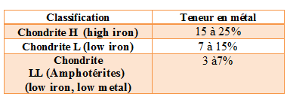
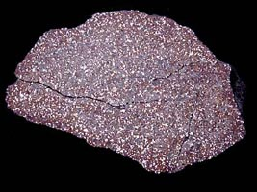
Chondrites: the most abundant observed falls (84%)
1-Ordinary chondrites (Groups H, L and LL) alone represent 80% of the meteorites discovered on Earth.
They consist of small beads called chondrules which are accumulated together.
Pultusk Meteorites

Slide 12
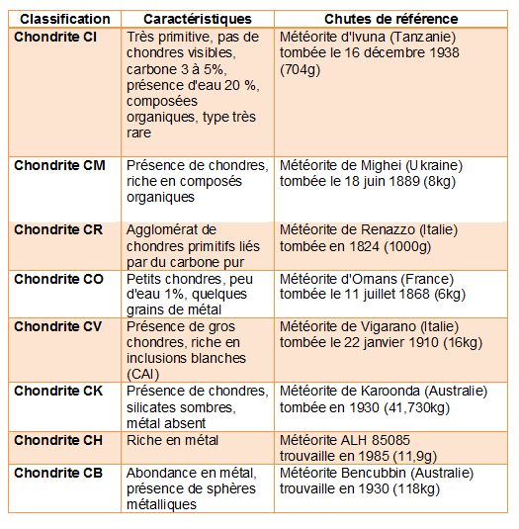
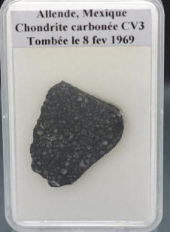
2- Carbonaceous chondrites (Group C)
ALLENDE METORITE
Dim: 2,5x2,2x0,2 cm /
Poids: 2,56g
(Chart with classification, characteristics and falls reference)

Slide 13
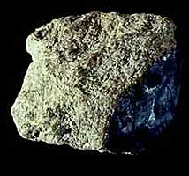
The Achondrite: 8%
Devoid of chondrules.
Essentially silicate.
Classified according to their calcium content.
Most to resemble terrestrial rocks.
The HED group: the largest number of Achondrites (6%). It is assumed that these meteorites come from the asteroid Vesta's crust.
The Ureilites (URE): They can contain diamond and are very difficult to saw.
The Aubrites (AUB): They are clear and contain unknown minerals on Earth.
The Angrites (ANG): Consisting mainly of olivine minerals, augite and anorthite.
Chassigny meteorite

Slide 14
The group S.N.C.:
These meteorites probably came from Mars. They are represented by three meteorites (Shergotty, Nahkla, Chassigny).
The lunar meteorites (LUN):
They are more expensive than the Martian meteorites.
Primitive achondrites:
In this group there are:
Branchinites the BRA (Branchina meteorite found in 1974),
Lodranites the LOD (Lodran meteorite fall of 1868),
The Acapulcoites (Acapulco meteorite fall of 1976),
The Winonailes WIN (Winona meteorite found in 1928).

Slide 15
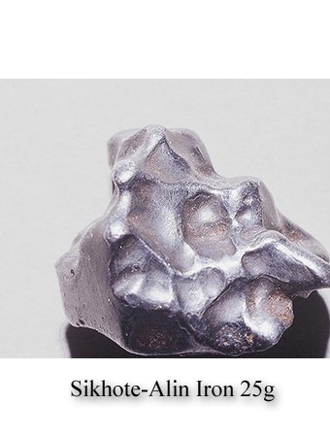
Metal, siderites
(6% des météorites)
It exists:
* The Octaédrites,
* The Ataxites and
* The Hexaédrites
Classified according to their nickel content.

Slide 16
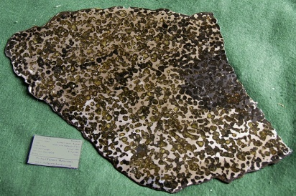
The Octaedrites :
These are the most numerous siderites. They attack with nitric acid of a polished face of this type of meteorite. It lets appear lines intersecting the network known as the figure Widmanstätten..
The Ataxites :
They do not have Widmanstätten structure visible to the naked eye; extremely small percentage of iron meteorites.
The Hexaédrites :
If we attack their surface with a network of bands called Neumann bands, hydrochloric acid may appear.

Slide 17
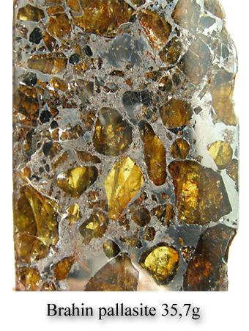
Metallo-stony meteorites,
Mixed
(2% of meteorites)
Mixture of metal and silicates.
It exists:
The Pallasites
The Mesosiderites

Slide 18
The Pallasites :
They are very fine aesthetic and polished wafer because they often contain crystalline olivine grains. It is the German Pallas who for the first time discovered this type of meteorite in 1775 in Siberia.
The Mesosiderites :
They probably come as the HED of the asteroid Vesta.

Slide 19
Conclusion
Meteorites are probably the first solids that are formed in the solar system. It's their age that we adopt to that of the solar system itself.
Today, we see a growing interest in these extraterrestrial rocks as both scientific and as amateur. The demand is increasingly strong, prices are rising.

Slide 20


Thank you for your Attention

