Slide 1
Variable Stars
25 years of Astronomy
By : Etteyeb Nejmeddine

Slide 2
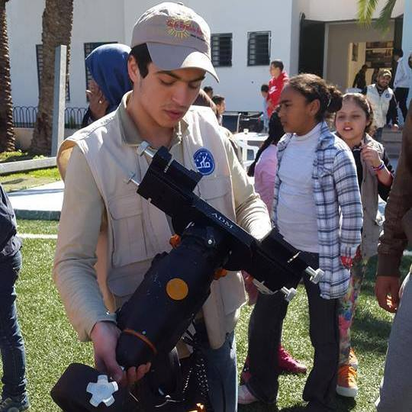
Etteyeb Nejmeddine
21 years old
The Astronomical Society of Tunisia (SAT)
The Charlie Bates Solar Astronomy Project (CBSAP)
Computer Science

Slide 3
What Are Variable Stars?
Detecting variability
Classification
Why study variable stars?

Slide 4
What are variable stars?
Variable stars are those that change brightness.

Slide 5
Detecting variability
The most common kinds of variability involve changes in brightness, but other types of variability also occur, in particular changes in the spectrum. By combining light curve data with observed spectral changes, astronomers are often able to explain why a particular star is variable.
Variable stars are generally analysed using photometry, spectrophotometry and spectroscopy.

Slide 6
Classification
Intrinsic
Extrinsic
wherein variability is caused by physical changes such as pulsation or eruption in the star or stellar system.
Pulsating variable stars
Rotating variable stars
Eruptive variable stars
wherein variability is caused by the eclipse of one star by another, the transit of an extrasolar planet, or by the effects of stellar rotation.
Eclipse binaries
Cataclysmic variable stars

Slide 7
Pulsating variable stars
Pulsating variables are stars that show periodic expansion and contraction of their surface layers. Pulsations may be radial or non-radial. A radially pulsating star remains spherical in shape, while a star experiencing non-radial pulsations may deviate from a sphere periodically. The following types of pulsating variables may be distinguished by the pulsation period, the mass and evolutionary status of the star, and the characteristics of their pulsations.

Slide 8
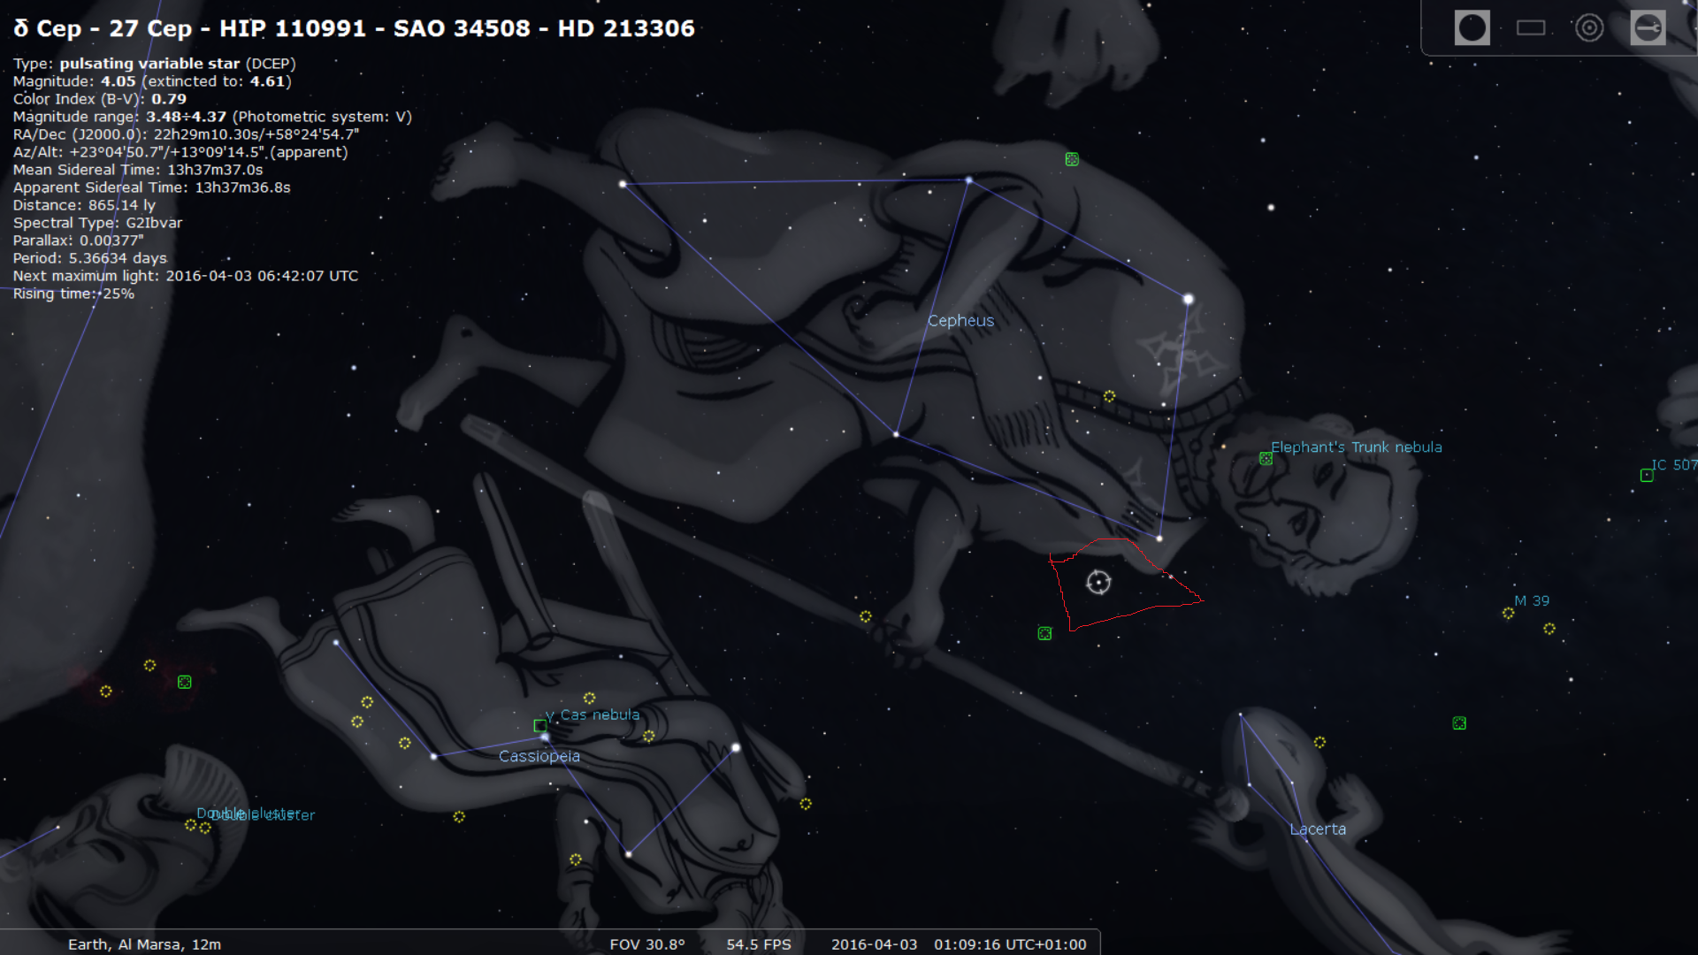
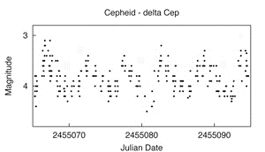
Cepheid's
Cepheid variables pulsate with periods from 1 to 70 days, with light variations from 0.1 to 2 magnitudes. These massive stars have high luminosity and are of F spectral class at maximum, and G to K at minimum. The later the spectral class of a Cepheid, the longer is its period. Cepheid's obey the period-luminosity relationship. Cepheid variables may be good candidates for student projects because they are bright and have short periods.

Slide 9
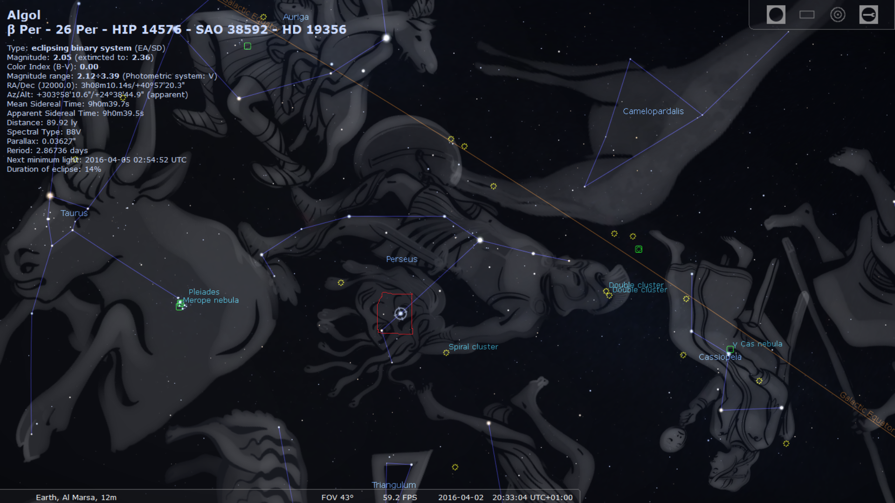
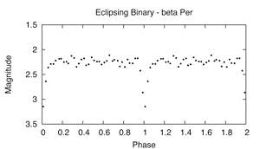
ECLIPSING BINARY STARS
These are binary systems of stars with an orbital plane lying near the line-of-sight of the observer. The components periodically eclipse one another, causing a decrease in the apparent brightness of the system as seen by the observer. The period of the eclipse, which coincides with the orbital period of the system, can range from minutes to years.

Slide 10
CATACLYSMIC VARIABLES
Cataclysmic variables as the name implies, are stars which have occasional violent outbursts caused by thermonuclear processes either in their surface layers or deep within their interiors. The majority of these variables are close binary systems, their components having strong mutual influence on the evolution of each star. It is often observed that the hot dwarf component of the system is surrounded by an accretion disk formed by matter lost by the other, cooler, and more extended component.

Slide 11
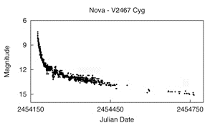
Novae
These close binary systems consist of an accreting white dwarf as a primary and a low-mass main sequence star (a little cooler than the Sun) as the secondary star. Explosive nuclear burning of the surface of the white dwarf, from accumulated material from the secondary, causes the system to brighten 7 to 16 magnitudes in a matter of 1 to several hundred days. After the outburst, the star fades slowly to the initial brightness over several years or decades. Near maximum brightness, the spectrum is generally similar to that of A or F giant stars.

Slide 12
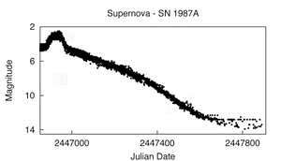
Supernovae
These massive stars show sudden, dramatic, and final magnitude increases of 20 magnitudes or more, as a result of a catastrophic stellar explosion.

Slide 13
ERUPTIVE VARIABLES
Eruptive variables are stars varying in brightness because of violent processes and flares occurring in their chromospheres and coronae. The light changes are usually accompanied by shell events or mass outflow in the form of stellar winds of variable intensity and/or by interaction with the surrounding interstellar medium.

Slide 14
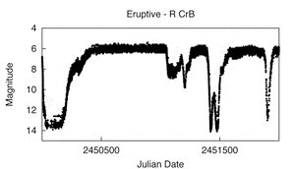
R Coronae Borealis
These rare, luminous, hydrogen-poor, carbon-rich, supergiants spend most of their time at maximum light, occasionally fading as much as nine magnitudes at irregular intervals. They then slowly recover to their maximum brightness after a few months to a year. Members of this group have F to K and R spectral types.

Slide 16
Why study variable stars?
Research on variable stars is important because it can provide fundamental information about the physical properties, nature, and evolution of stars. Distance, mass, radius, internal and external structure, composition, temperature, and luminosity can be determined using variable star data.
Since professional astronomers have neither the time nor the resources needed to gather data on the brightness changes of thousands of variables, amateurs have been making a real and useful contribution to science by observing variable stars and submitting their observations.

